Slide 1
The Procurement Cycle
Barbara Morton
Director, Sustainable Procurement Ltd
Asuncion, Paraguay
27 October 2014

Slide 2
Outline & Objectives
Integrating sustainability criteria at appropriate stages of the procurement cycle
Sharing experiences and learning

Slide 3
The Procurement Cycle
Identify need & assess risk
Specification
Supplier Selection
Evaluation and Award
Supplier Management
Contract Management
Good Procurement is Sustainable Procurement
Stakeholder
and supplier engagement
Notes:
Explain that sustainability needs to be embedded and is not a bolt-on but part of good procurement.
This slide illustrates that the course continually relates to the ‘procurement cycle’ and its key stages – BUT particularly emphasises that Stakeholder and Supplier Engagement is a major consideration at every stage of that cycle and this will be referred to throughout the course.
Stakeholder and Supplier engagement in developing SPP approach includes:
Developing approach to SPP
Why, Who, How; Risks, barriers & challenges;
Stakeholders as part of the delivery process
Innovation; leadership; consultation; identifying common priorities; shared learning;
Certification, accreditation and standards; legal considerations;
Types of engagement
Benefits of co-operating on promotion of SPP
Risks of not co-operating and working together:
Stimulating new product development
Risks, barriers and challenges; legal considerations; Pre-Procurement

Slide 4
Risk Management Options
Re-think need to reduce the risk
The risk cannot be managed through procurement
Addressed in the specification
Managed by choice of supplier
Supplier provides proposals for evaluation (bid evaluation)
Managed by targets to be delivered after contract award
Notes:
This slide is used throughout the Modules to highlight where risk can best be managed.
The first step is to re-think the need to purchase. (Later slides address subsequent stages).
Risks that can’t be managed through procurement: the identification of risks may reveal some risks that arise from the way the organisation operates. So these risks are best managed through, for example, changes in organisational policies or ‘rules’. For example, changes in organisational policy on home-working will affect the need for office equipment, ICT, furniture and consumables.

Slide 5
The Waste Hierarchy
Waste prevention
Re-use
Recycle/compost
Energy recovery
Disposal

Slide 6
The Procurement Hierarchy
Reduce
Re-think!
Replace
Return Reuse Recycle
End-of-life management

Slide 7
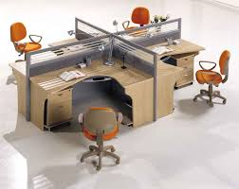
Furniture re-use
Rethink the need
Reduce
Re-use
Recycle
Perth & Kinross Council
Year | Expenditure
09/10 | £292k
10/11 | £131k
11/12 | £61k
12/13 (projected) | £33k
Energy recovery
Notes:
After attending Marrakech Approach to SP in Scotland, Perth and Kinross Council applied the principles of procurement hierarchy to their procurement of furniture.
Resulting in considerable reduction on expenditure on furniture year on year from almost £300k to just 10% of this figure over a four year period.
Also mention that furniture remodelling is gaining market share / popularity as organisations take existing furniture and either refurbish them (cleaning, repair) or remodel them, a good example of this is where office space is to be populated by more staff, perhaps as a result of estate rationalisation, and the current desks are too large, they can be cut down to provide smaller work stations and therefore fit more desks per sq ft than previously possible. Premier sustain offer this service as well as many others.
If purchasing new furniture, consider whether re-modelling may be required in the future and procure with this in mind.

Slide 8
Influencing the market
Tender Process
Demand Management
Supplier Development
Supplier Capability
Sustainable Outcomes
Sustainable Criteria
Assess Need
Specification
Supplier
Selection
Evaluation
Contract
Management
Influence
Time
The greatest impact can be made in the early stages of procurement and commissioning. Note the opportunities during the life of the contract too.

Slide 9
Closed Loop Business Models
X
X
Raw
Materials
Disposal
X
X
Production
Consumption
Transport

Slide 10
Case study
Aberdeenshire Council
The ReEntry® carpet tile take-back scheme is run in partnership with three specialist firms: Pennine Magpie, Green Works and Spruce Carpets. They sort, grade and clean old carpet tiles, which are then made available to charity and community groups at prices they can afford.
InterfaceFLOR has already removed around 70 pallet-loads of old carpet tiles from the Council’s office for repurposing.
New carpet containing pre-consumer recycled content was then installed.

Slide 11
Developing the Specification
Notes:
Having reviewed the need, we may have decided that we do still need to procure the item or service. We now need to make sure that we develop a specification that seeks to address the key sustainability risks

Slide 12
The Procurement Cycle
Identify need & assess risk
Specification
Supplier Selection
Evaluation and Award
Supplier Management
Contract Management
Good Procurement is Sustainable Procurement
Stakeholder
and supplier engagement
Notes:
Explain that sustainability needs to be embedded and is not a bolt-on but part of good procurement.
This slide illustrates that the course continually relates to the ‘procurement cycle’ and its key stages – BUT particularly emphasises that Stakeholder and Supplier Engagement is a major consideration at every stage of that cycle and this will be referred to throughout the course.
Stakeholder and Supplier engagement in developing SPP approach includes:
Developing approach to SPP
Why, Who, How; Risks, barriers & challenges;
Stakeholders as part of the delivery process
Innovation; leadership; consultation; identifying common priorities; shared learning;
Certification, accreditation and standards; legal considerations;
Types of engagement
Benefits of co-operating on promotion of SPP
Risks of not co-operating and working together:
Stimulating new product development
Risks, barriers and challenges; legal considerations; Pre-Procurement

Slide 13

Key Sustainability Issues
To achieve sustainability i.e. to minimise our impact on the environment and promote social equality we need to take an integrated approach to the multiple aspects of our work and daily lives, ensuring we consider not just economic but also environmental and social issues, which may include the following:
✓ Environmental issues
CO₂ and other Greenhouse Gas Emissions (GHGs)
Other emissions to air
Emissions to water
Hazardous substances
Materials and natural resources
Climate change adaptation
 Socio-Economic issues
Health and well-being
Education
Employment
Community
Labour Standards and Human Rights
Equality and Diversity
Fair and ethical trade
Energy
Water
Waste
Biodiversity
Local environment

Slide 14
Developing the specification – some general principles
Fossil fuel usage
Water consumption
Transport
Packaging
Single-use items
Hazardous materials
Poor working conditions
MORE
Energy & resource efficiency
Renewable energy
Recycled & reusable items
‘Local supply’
Skills & capacity
Fair and ethical trade
LESS
According to key sustainability risks & opportunities
Notes:
Specifications and the terms and conditions within a tender need to reflect the main objective of the contract but also to have a grounding in the organisation’s objectives and policies. Through stakeholder engagement a rounded specification can be developed that enables the wider ambitions of the organisation to be met rather than the narrower scope of a single department.
It is important to have clear agreement on what the organisation wants more of and what it wants to reduce to embed those requirements into contract specifications.
For example in some service contracts it is possible to include social benefits in terms of jobs and skills which will be part of the organisaion’s priorities.

Slide 15

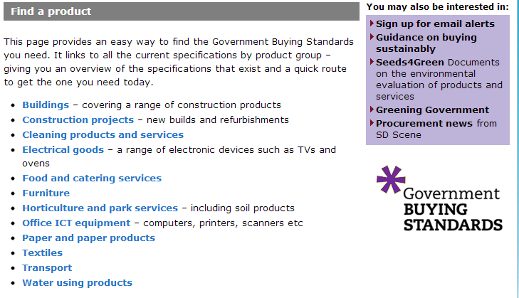
Government Buying Standards (GBS)
Mandatory and Best Practice Specifications

Slide 16
EU GPP criteria
The EU GPP criteria were a step forward
http://ec.europa.eu/environment/gpp/first_set_en.htm
The European Commission’s environmental criteria and were developed for 19 product categories.
They identified key environmental risks
  e.g. pollution, waste, water, energy and resource efficiency
Research was carried out by consultants to develop criteria relevant to different product groups to address these risks.
http://ec.europa.eu/environment/gpp/index_en.htm

Slide 17

Light bulbs - specification
Impact area | Best practice
Energy Consumption in use | Compact fluorescent and white light emitting diode lamps: Same as minimum specification and complies with the criteria of the Energy Saving Recommended Scheme. Other lamps: High pressure sodium lamps should be ‘plus’ types; Metal halide lamps should be ‘ceramic’ types; Low-pressure sodium lamps should be ‘Eco’ types.

Slide 18

Supplier selection
...how do we decide who is suitable?

Slide 19
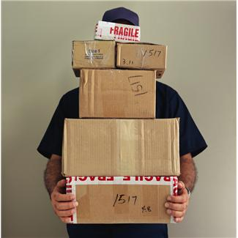
Importance of selecting suppliers who are able to address sustainability considerations...
Suppliers and sustainability risks:
Suppliers control or potentially influence many key impacts;
  Their own manufacturing / service processes
  Their own procurement
They may therefore have varying degrees of influence on the life cycle sustainability risks in the supply chain

Slide 20

Tender/Bid Evaluation and Contract Award
Evaluating bids

Slide 21
Evaluation...
Although this is not an exact science they must be relevant, transparent and structured and key issues to be considered will be:
What should the balance between cost and quality (including sustainability) be. While procurers may apply, for example, a 40% cost - 60% quality (inc. sustainability) weighting - is this appropriate for the contract in question? Think about the specifications we have set and the relative importance of sustainability issues against others. Does this reflect Whole Life Costs?
Where are the sustainability risks being managed? Have we addressed these through the Supplier selection stage or setting sustainability specifications?
  Remember: Prioritisation produces a range of matrices which enable us to identify, according to categories of procurement:
  These will help you understand where sustainability issues need to be addressed, including the focus within weightings.
RISK:
...Where to prioritise initial action according to sustainability risks
SCOPE:
...Where YOU can do more to improve sustainability
INFLUENCE:
...Market engagement strategy
!
Notes:
As we consider later, factoring relevant sustainability issues into the financial considerations (and Whole Life Cost analysis), such as energy in use costs – so bidders can be asked to specify costs over a period of time, upfront costs plus usage costs which can be compared.

Slide 22
Award Criteria
Award criteria (referred to in UK Regulations) include:
Quality
Price
Technical merit
Aesthetic and functional characteristics
Environmental and social characteristics
Running costs
Delivery date and delivery period
Cost effectiveness
After sales service
Technical assistance
Key Award Criteria:
Minimum
  Criteria which a bid must meet
Preferred
  If a bid cannot meet these it does not necessarily stop it from winning
Notes:
The main points to emphasise are that environmental characteristics in particular are clearly identified as a legitimate element within award criteria. Note that this helps to confirm also that sustainability is part of good procurement practice.

Slide 23
Applying tools to deliver GPP
Life cycle costing
The higher initial price of the greener product is more than compensated by the much lower usage
and disposal costs.

Slide 24
Life cycle savings in lighting
High level assessment of the potential benefits of a pan-Scotland Investment in Street Lighting LEDs
2012 pilots – developed a business case
Forecast that an investment of £298m could generate savings of £1.3bn over a 20 year operational period
67% reduction in energy consumption
1.35 m tonnes of carbon over 20 year period of analysis
32 local authorities in Scotland

Slide 25
Cars - Contract management
Impact area | Best practice contract performance criteria
Cars | The contractor must selectively collect used lubricant oils and tyres and have a contract with one or several authorised waste management organisations for the correct treatment of these waste fractions.

Slide 26
Product Conditions: Examples
‘Packaging must consist of readily recyclable material, and/or materials taken from renewable resources, or be a multi-use system, i.e. reusable.
All packaging materials shall be easily separable by hand into recyclable parts consisting of one material (e.g. cardboard, paper, plastic, textile).’
Supplier required to improve energy efficiency of products supplied by 5% within 12 months of contract award
What is a suitable Contract Management Requirement?
Notes:
There is often more scope than is immediately obvious to include sustainability considerations – see the packaging requirements in this example. Must be proportionate and relevant.
These are already set in Specification stage.
Discuss what an appropriate contract requirement would be.

Slide 27





In Summary: Sustainable Procurement Principles
Applying these will ensure that risks are managed and opportunities captured:
  Mitigating relevant environmental and social risks and realising opportunities for the benefit of your organisation as well as society and the environment
  Consideration of the full Life Cycle of the goods or services procured
  Life cycle impacts considered according to Capital items, Consumable items or Services procured
  Prioritising actions to maximise benefits
NEED?
  Use of a Procurement hierarchy to inform action in addressing risks and realising opportunities
  Incorporation of sustainability considerations as early as possible in the procurement process

Slide 28
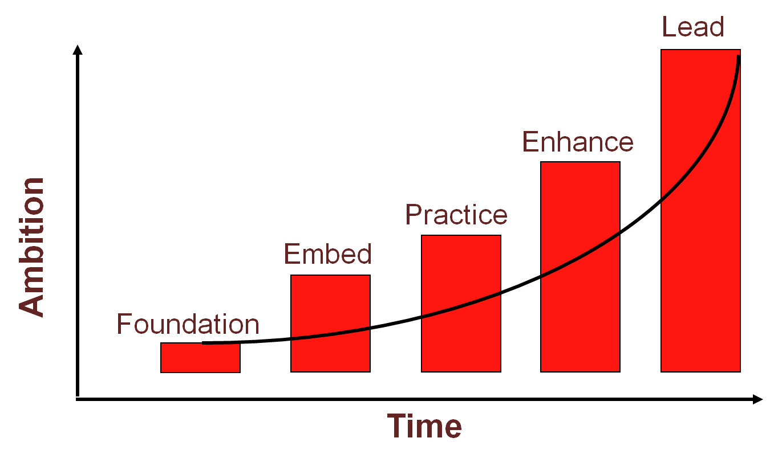
Monitoring and Reporting
What is monitored and measured?
By whom?
How?
When?
Why?
What is reported?
By whom?
To whom?
When?
Why?
Flexible Framework is only one way of demonstrating progress
  Maturity matrix
People
Objectives, policy and communications
Procurement process
Engaging suppliers
Monitoring and reporting
Strategic planning – key stakeholders involved

Slide 29
References
NSPPP Prioritisation Methodology – http://sd.defra.gov.uk/advice/public/nsppp/prioritisation_tool
Government Buying Standards – http://sd.defra.gov.uk/advice/public/buying
Green Public Procurement – http://ec.europa.eu/environment/gpp/toolkit_en.htm
Buying Green - http://ec.europa.eu/environment/gpp/pdf/handbook.pdf
Buying Social - http://ec.europa.eu/social/BlobServlet?docId=6457&langId=en
Procuring the Future 2006 - http://www.defra.gov.uk/publications/files/pb11710-procuring-the-future-060607.pdf
Carbon Plan – https://www.gov.uk/government/publications/the-carbon-plan-reducing-greenhouse-gas-emissions--2
UK Public Contract Regulations – http://www.legislation.gov.uk/uksi/2006/5/contents/made
BASE – http://base-uk.org
Energy Efficiency Directive: http://ec.europa.eu/energy/efficiency/eed/eed_en.htm
The Cleaner Road Transport Vehicles Regulations 2011: http://www.legislation.gov.uk/uksi/2011/1631/made
Commission v Netherlands: http://curia.europa.eu/juris/document/document.jsf?text=&docid=122644&pageIndex=0&doclang=EN&mode=re
Public Services Social Value Act: http://www.legislation.gov.uk/ukpga/2012/3/contents/enacted

Slide 30
Summary
Sustainable procurement is good procurement
A powerful tool
Understanding risks and opportunities
Whole life approach
Early engagement is key
Finding the appropriate balance:
  Economic, social and environmental considerations
It is about delivering sustainable outcomes.

Slide 31
Thank you for your attention
Barbara Morton
Sustainable Procurement Ltd
barbara@sustainableprocurement.eu.com

